Slide 1
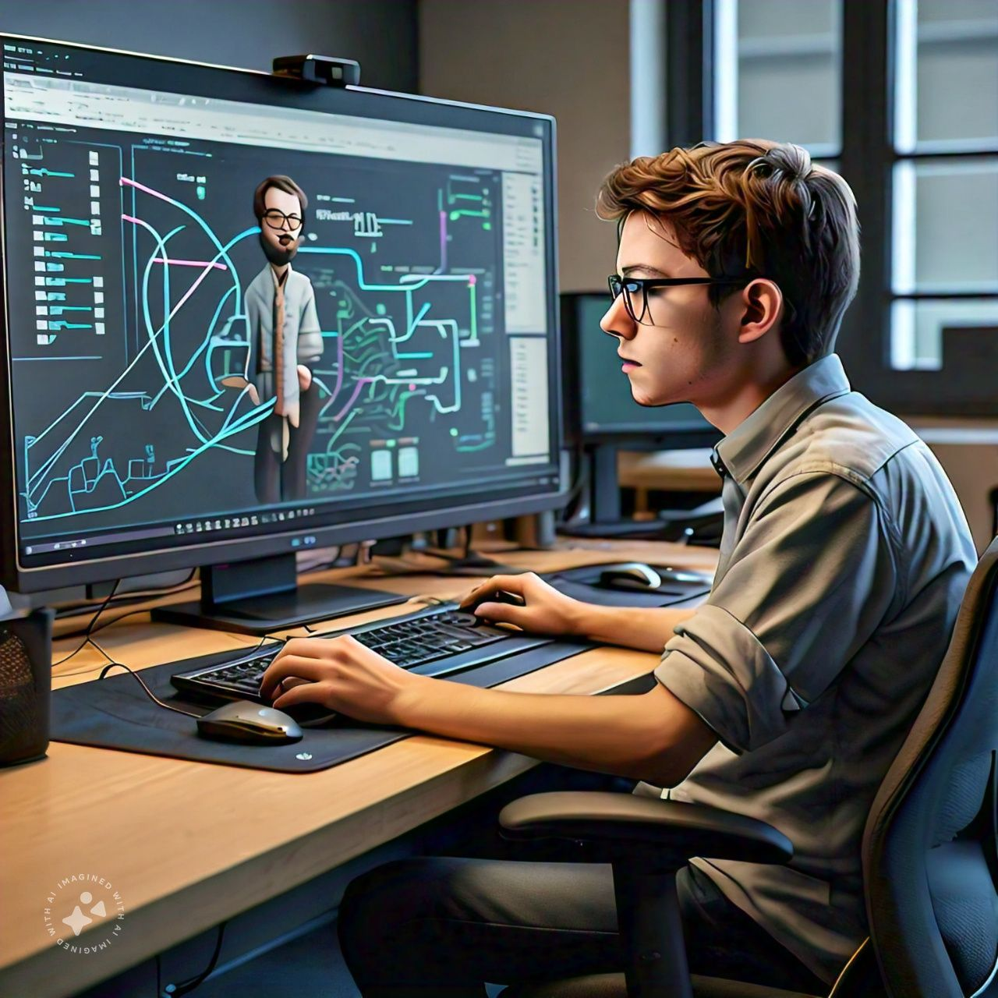
Unique characteristics of design thinking
1. Human-Centered: Design Thinking focuses on understanding the needs, desires, and limitations of the end-users.
2. Empathetic: It involves actively listening to and observing users to gain a deeper understanding of their experiences.
3. Iterative: Design Thinking is a non-linear process that involves continuous refinement and testing.
4. Collaborative: It encourages cross-functional teams to work together.
5. Flexible: Design Thinking adapts to changing circumstances and user needs.
6. Creative: It emphasizes exploring multiple solutions and thinking outside the box.
7. Experimental: Prototyping and testing ideas is crucial.
8. Solution-Focused: Design Thinking prioritizes finding solutions rather than just identifying problems.

Slide 2
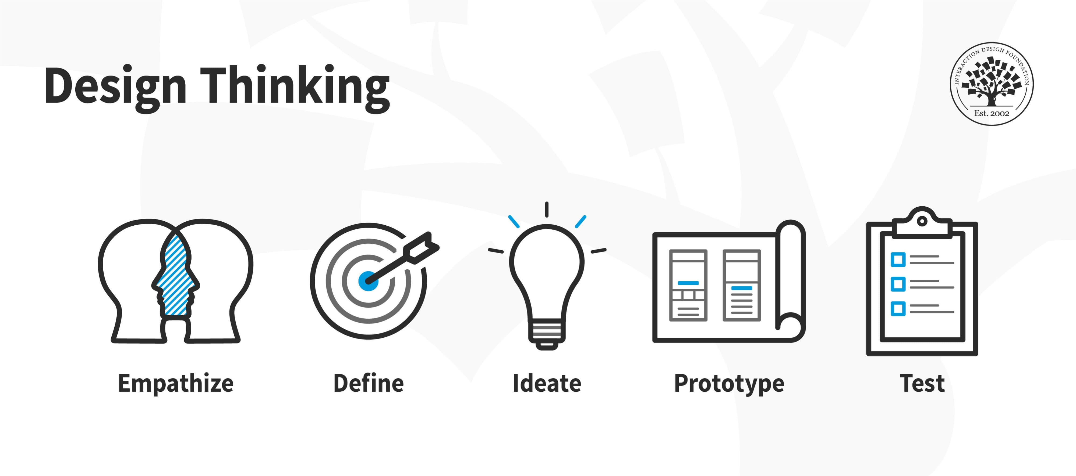
FLOW CHART

